Slide 1
Junior Cycle
Classrooms Based Assessments

Slide 3
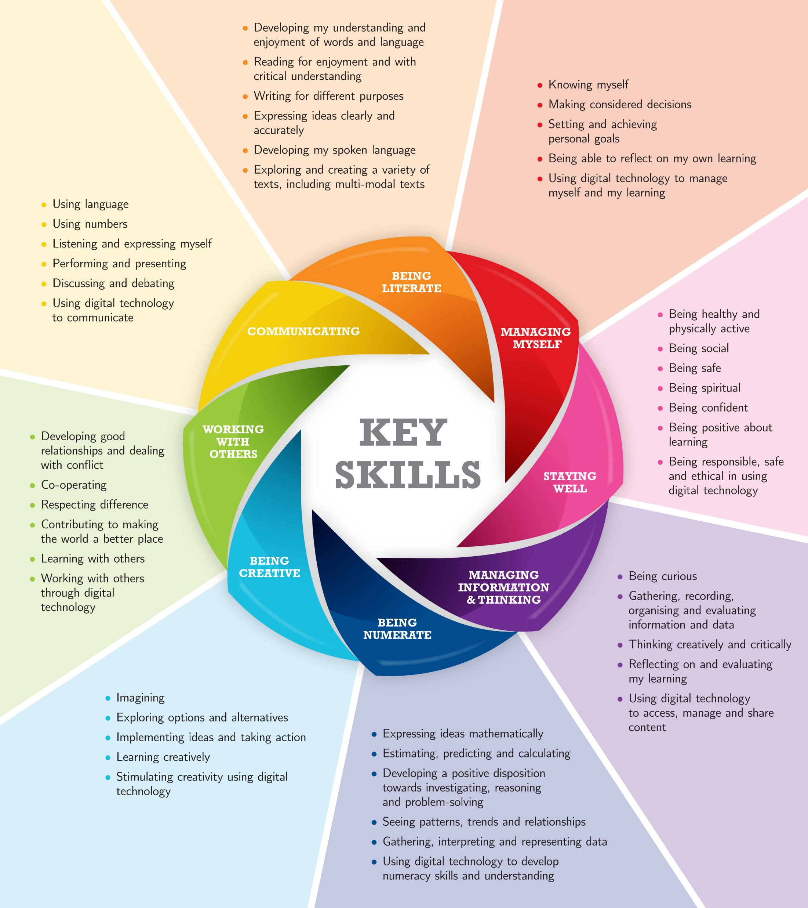

Slide 4
400 hours over 3 years
Physical Education – short course
SPHE (social, personal and health education) – short course
CSPE (civic, social and political education) –short course
Digital Literacy and guidance

Slide 5
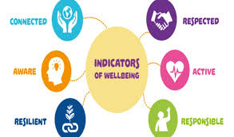

Slide 7
Classroom Based Assessments (CBA’s)
CBA’s provide an opportunity for independent learning
Students will undertake two classroom based assessments in each subject, one in second year and one in third year (except in Gaeilge, both take place in third year). These are facilitated by the teacher and the type of assessment varies for each subject
CBA’s allow students to demonstrate their understanding of concepts and skills and give students an opportunity to demonstrate these in ways which may not be possible in an externally assessed examination
Students will also undertake CBA’s in their wellbeing subjects – PE, CSPE and SPHE

Slide 8
Grading of Classroom Based Assessments
The grading system used for CBAs comprises of a ‘Descriptor’ rather than a percentage.
Classroom Based Assessment Descriptors
Exceptional
Above Expectations
In Line with Expectations
Yet to meet Expectations
These are the possible grades that can be achieved by students in their CBA. ‘In line with Expectations’ is the most common grade achieved

Slide 9
Ensuring Quality
Schools will organise ‘Subject Learning and Assessment Review’ meetings
Teachers will compare their assessment of students’ work and ensure a common approach across the school . Descriptors are awarded to students based on subject specific ‘Features of Quality’. Further information about the content of these CBAs is available on the JCT website www.jct.ie
CPD has been provided to teachers to ensure that the Classroom-Based Assessments align to a national standard
CBA’s are reported on in the students JCPA

Slide 10
Assessment Task
The written Assessment Task is marked by the State Examinations Commission
It may require the student to demonstrate an understanding of the knowledge and skills developed during the second classroom based assessment in third year
The written Assessment Task may also provide an opportunity for students to refer to skills and competencies that were developed and describe ways in which their learning might be applied to new situations
The Assessment Task will be completed in class under the supervision of the teacher and will be sent to the SEC for marking with the script for that subject in the state-certified examination at the end of the third year

Slide 12
Grading in the State Examinations
Distinction 90% - 100%
Higher Merit 75% - 90%
Merit 55% - 75%
Achieved 40% - 55%
Partially Achieved 25% - 40%
Not graded 0% - 20%

Slide 14
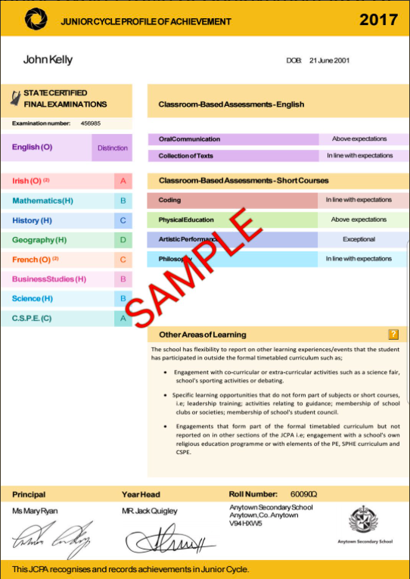

Slide 15
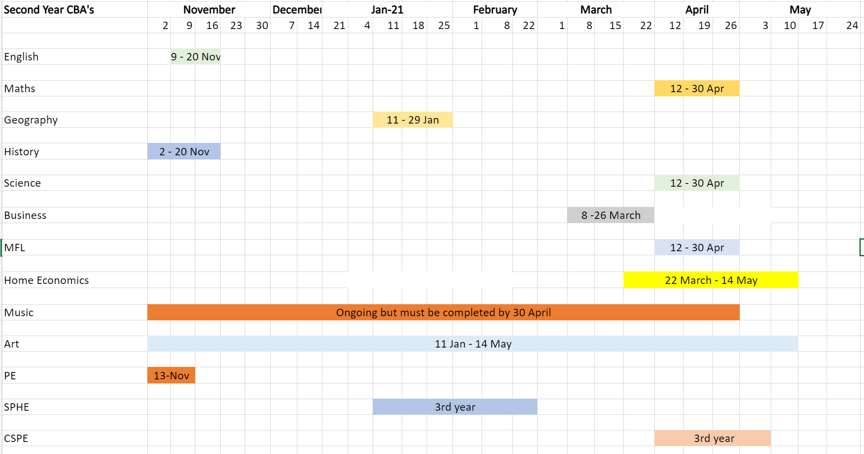
Schedule of 2nd year CBA’s per subject

Slide 16
Further information
More information on the junior cycle can be found at
jct.ie
ncca.ie

