Slide 1

Effective Study Skills
Starting the Conversation
Monday, 5th November, 2018
Monday, 12th November, 2018
HFSS Tutorial Time

Slide 2

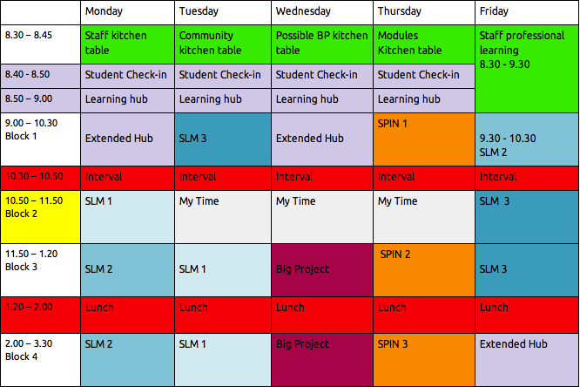
Week 1 & 2 of Effective Study Skills
In your journal, just a few pages after pg. 68 and before the Homework section starts, there is a section on “Study – Recommended Practice”.
Today in Tutor time, we are going to concentrate on the first page of this study section.
There are 6 weeks to the Christmas 2018 exams, so today is the day to draw up a study timetable!

Slide 3
Our 2 Tutorial sessions involve:
Establishing a Study Routine
2. Looking at one Memory Technique – Flashcards
3. Drawing up a Study Timetable

Slide 4


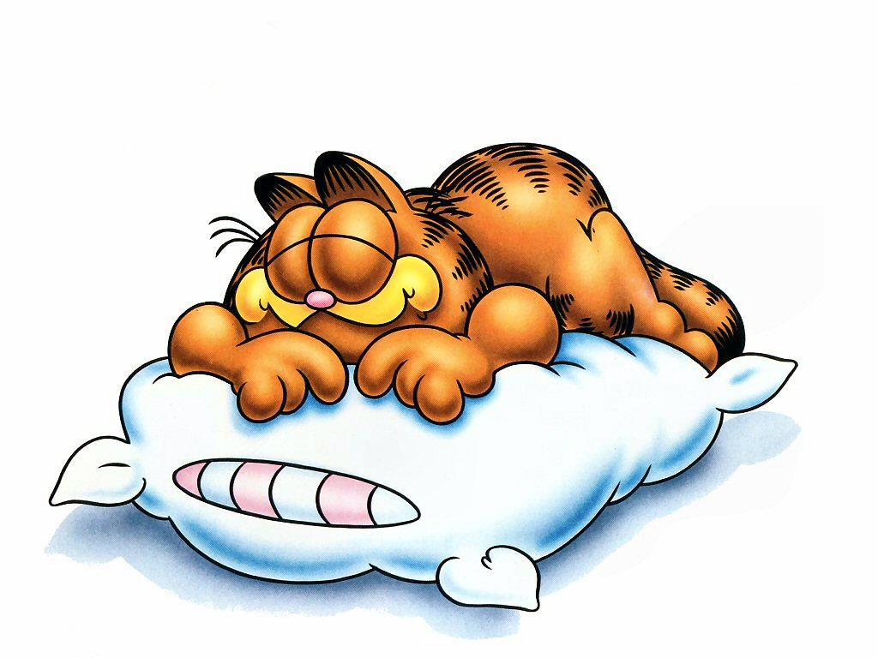
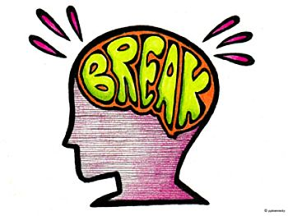

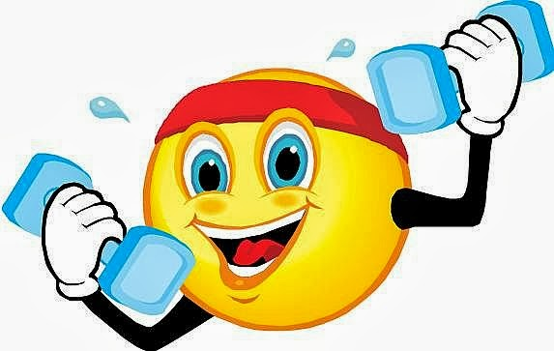
1. Study Routine
– Orange mini section in your journal
To ensure Effective Study, the following factors are imperative:
1.Water – If you can’t think straight, Hydrate!
2.Foods – those that Fuel your Brain
3.Sleep – at least 8 hours at night
4.Regular breaks incorporated into your Study Timetable
5.Regular Exercise – It’s been scientifically proven!
Eg. A quick, brisk walk
6. A Positive Mental Attitude – I Can Do this – Watch me!!
All 6 Factors are required collectively, to ensure Effective Study!

Slide 5

1. STUDY ROUTINE
Your Place of Study should ALWAYS:
Be available to you
Be free from interruptions & distractions (Phones off and away)
Have all of your books, copies & papers on hand
Have a large enough desk / table and chair
Have enough light
Be kept at a comfortable temperature

Slide 6

6 Study Habits of Successful Students
• Plan specific times for studying
• Set specific goals for your study time
• Start studying when planned
• Work on the most difficult material first
• Eliminate distractions during study time
• Review and revise work over the weekends

Slide 7
2. Memory Technique – Flash cards
Flashcards are a very useful tool in learning or remembering information such as: Vocabulary Words and Meanings, Maths Formulae, History Facts, Geography Terms, Science Diagrams and Correct Spellings or Words for Languages etc.
You don’t need to buy expensive cards to create your flash cards, check out Dealz and Tesco. There are also Apps online that will create them for you, if you prefer to print than handwrite your own.
Flash cards help you self-assess. You are basically testing yourself, and if you don’t know the answer, well it’s on the back of you card! Ask parents/guardians to test you too.
TIP: Have a few empty containers to store your cards, or elastic bands to keep them together.
Effective Use of Flash Cards = Colour code your cards by subject or topic
If you are a member of Studyclix, they now have flashcards ready to print for you

Slide 8
2. Example of a Flash Card
Diagram on front with numbered labels.
Test yourself to see how many you know.
Solutions on the back in one quick flick!

Slide 9


3. Time Management
A Study Timetable should include specific subject targets – not just the name of the subject
Geography
Geography
Volcano Formation

Slide 10

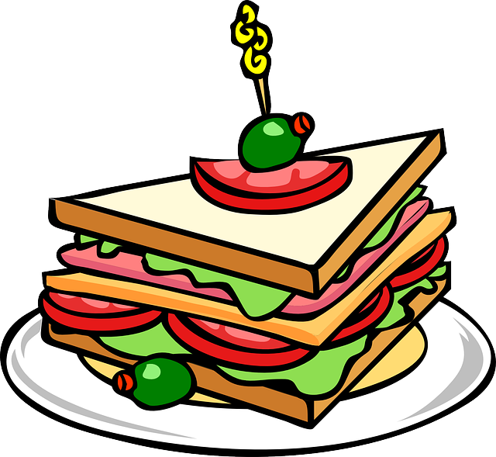



Ensure you schedule the following into your Study Timetable:
Homework
Extra-curricular activities
Lunch / Dinner
BREAKS – 10 minutes after every hour (Hydrate, Activate etc.)
Family Time /Chores

Slide 11
Sample Template for Weekly Study Timetable –
As you can see it’s also unfinished! Note Study ends before10pm
 | Monday | Tuesday | Wednesday | Thursday | Friday | Saturday | Sunday
09:00 |  |  |  |  |  | Geography Volcanoes | Chemistry Stoichiometry
10:00 |  |  |  |  |  | Maths Algebra | Gaeilge Aiste
11:00 |  |  | School |  |  | German Oral – School | Mass
12:00 |  |  |  |  |  | English Essay on Othello | Sarsfields
13:00 |  |  |  |  |  |  | Match
14:00 |  |  | Homework |  |  |  | Visit Granny
15:00 |  |  | Homework |  |  |  | Shopping
16:00 |  |  | Piano lesson |  |  |  | Prepare school bag and lunch
17:00 | Homework | Homework | Dinner | Homework | Homework
18:00 | Homework | Homework |  | Homework | Homework
19:00 | Sarsfields | Gaeilge Aimsir Chaite |  | Gaeilge Comprehensions | German Letters
20:00 | Football | Maths Statistics |  | Chemistry Organic | English Othello
21:00 | English Novel Chapters 4-6 | Geography Rocks |  | Walk Dog | Maths Do Revision Qs |  | Read magazine Bed Early

Slide 12

Over To YOU….
Design your own, unique Study Timetable for this week
Set attainable targets for each study session
Don’t forget to take a break after 1 hour of study
(Similarly, Don’t forget to go back to study!)
If you have Orals, you will need to ensure you practise speaking out loud
If you have Aurals, you will need to devote time to practising your listening
If you have Practicals, you will need to devote time to practise your skills
You Can Do This! Best of Luck!
We’ll check in next Monday with any questions or ideas that you may have.
Your Year Head will also be discussing Effective Studying at your next Assembly.

Slide 13

Reminder: Christmas Exams commence December 17th, 2018* *for most year groups.

